Slide 1



📽️Movie Review website using Database 🎥
SUBMITTED BY:
ASHA KUMARI SOREN
JYOTI
RAJAT RANJAN
SHUBHAM
ABHIJEET SHANDILYA
HEAD OF DEPARTMENT:
NITISH SIR.
MENTORSHIP:

Slide 2

Why it is important to review any movie ?

Slide 3

To summarize the film so that people have more information with which to gauge their interest in the film.
To compare the film to similar films that came before it so that people have a frame of reference.
To help those with limited money and opportunity to go to the movies decide which film is most worth their time and money.
To help great independent films generate buzz and funding for distribution.
To clue people in as to whether they ought to pay full admission, matinee price, dollar movie price, or wait until the film is on video.

Slide 4






📽️🧑‍💻 Team members 🧑‍💻🍿
Asha kumari soren worked on HTML.
Jyoti Kumari Worked On CSS.
Rajat Ranjan Worked on Devlopment server.
Abhijeet Shandilya worked on Javascript or Backend.
Shubham worked on Frontend.
Asha Kumari Soren
Jyoti Kumari
Rajat Ranjan
191007
191062
191023
Abhijeet Shandilya
Shubham
191039
191016

Slide 5

In This presentation you will find. 🔍
Problem
Problem statement.
Scope of the project
Methodology for Movie Recommendation
Abstract
Concluson and future scope
Till Date progress

Slide 6

Problem
Suppose someone wants to watch a movie like any movie whatever He/she wants to watch then that person asked from their friends , relative or many other people about that movie different people different suggestion but still He/she doesn't satisfied to all this .
After all He/she go through online fot that particular movie review still same situation different site different review like 👇🏻
Rotten Tomatoes :- Movies, Movie Reviews, Critic Scores, Showtimes and Movie Trailers - The Ultimate Movie Database!
IMDB - Internet Movie Database :- It's a huge collection of movie information.
Roger Ebert - movie reviews :- Movie reviews, essays, interviews and the Movie Answer Man from film critic Roger Ebert and contributors.
Metacritic:- Movie Reviews, TV Reviews, Game Reviews, and Music Reviews

Slide 7
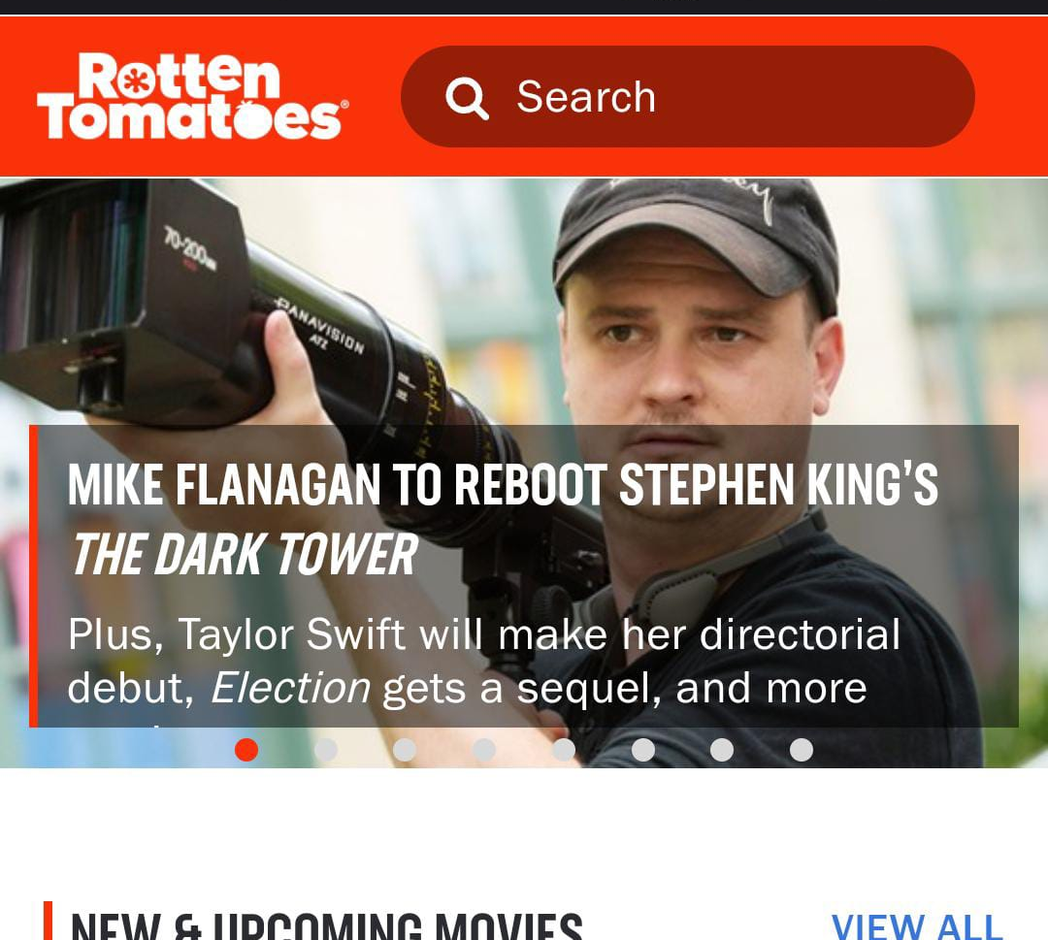


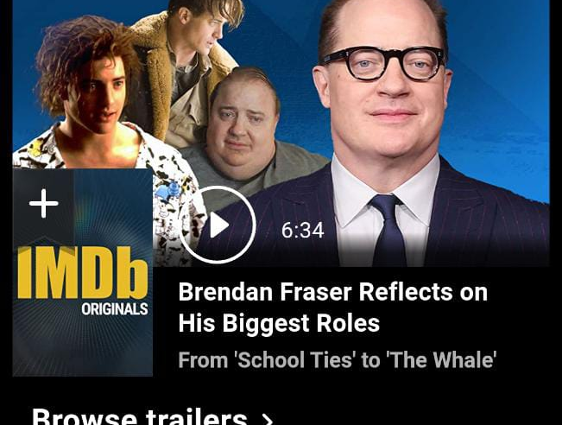
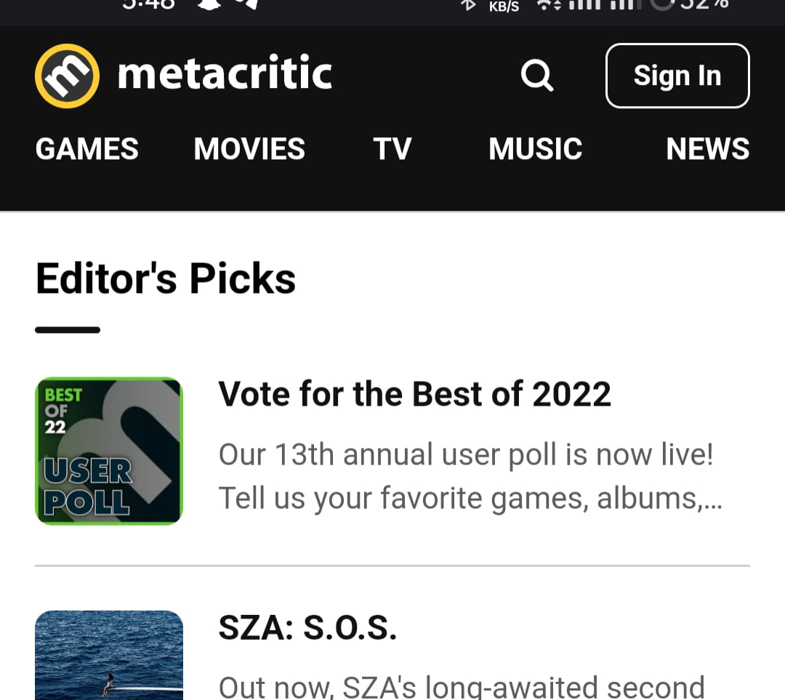
Different site different reviews
?
All sites showing different- different reviews
😓😖
?
?

Slide 8

Problem statements
The goal of the project is to recommend a best movie to the user.
Providing related content out of relevant and irrelevant collection of items to users of online service providers
He/She can find overall of review from collected from all popular review site putted here average review/rattings or points.
As u know most of the review sites are one only for review but He/She not able to Watch online or Booked.
But here you can do.😊

Slide 9
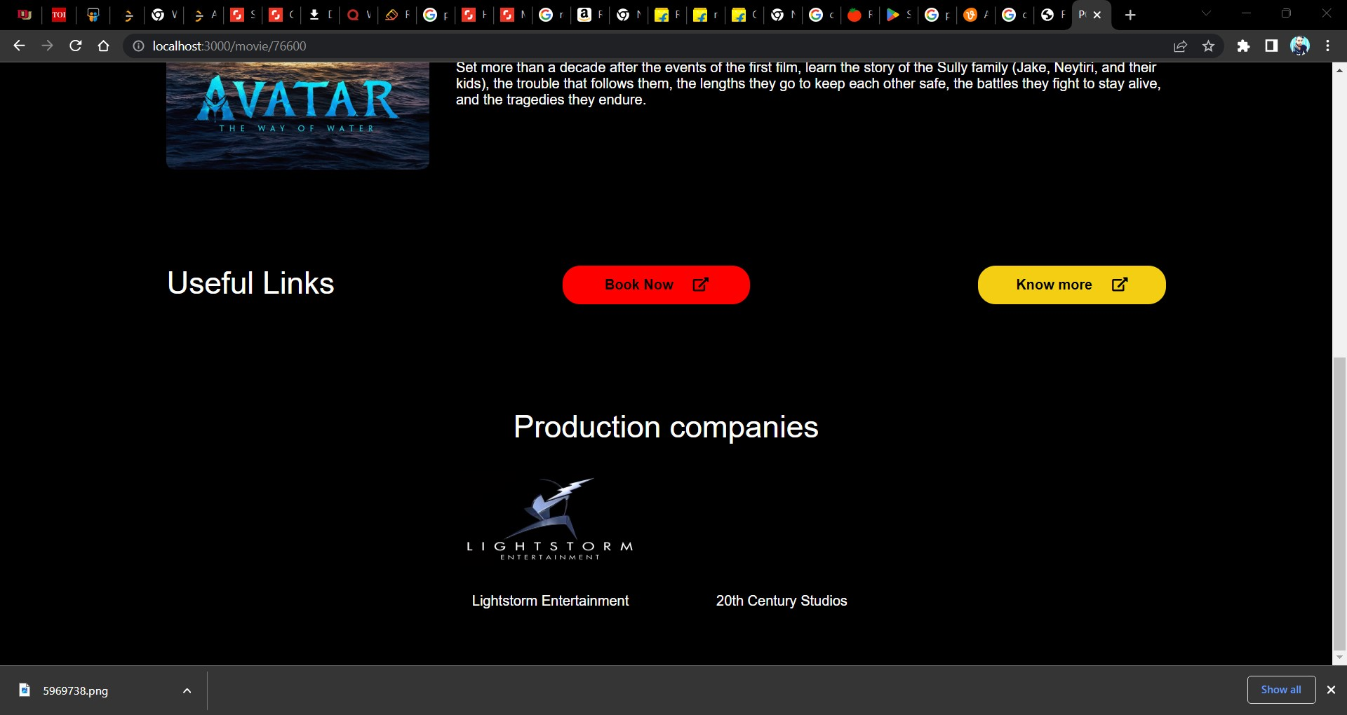
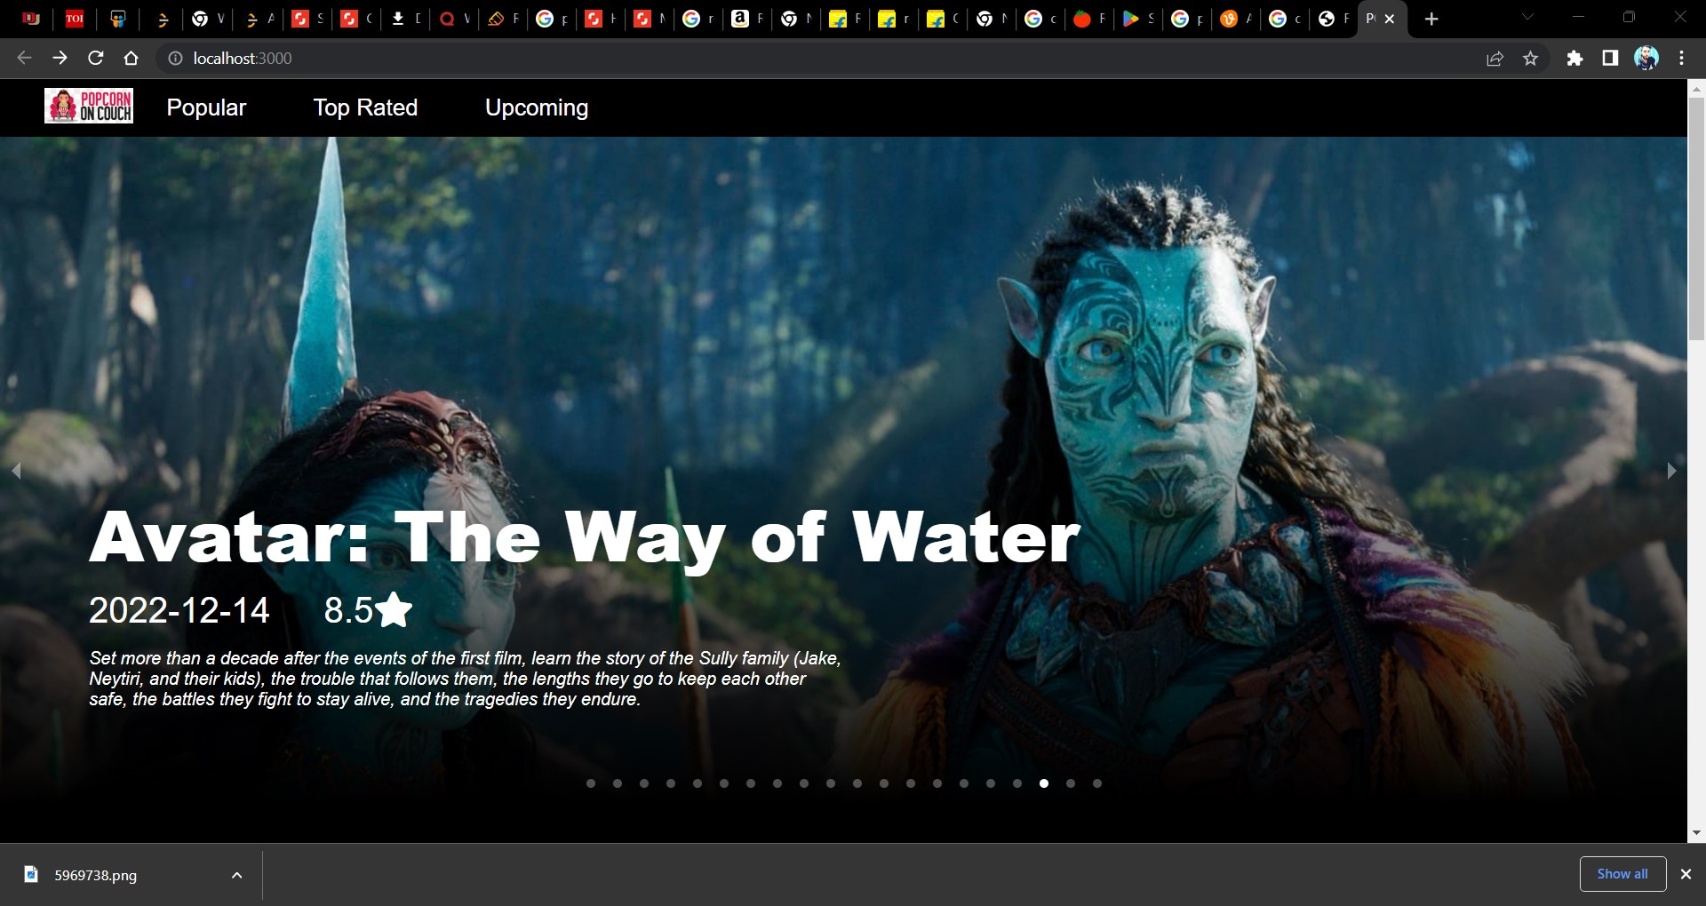
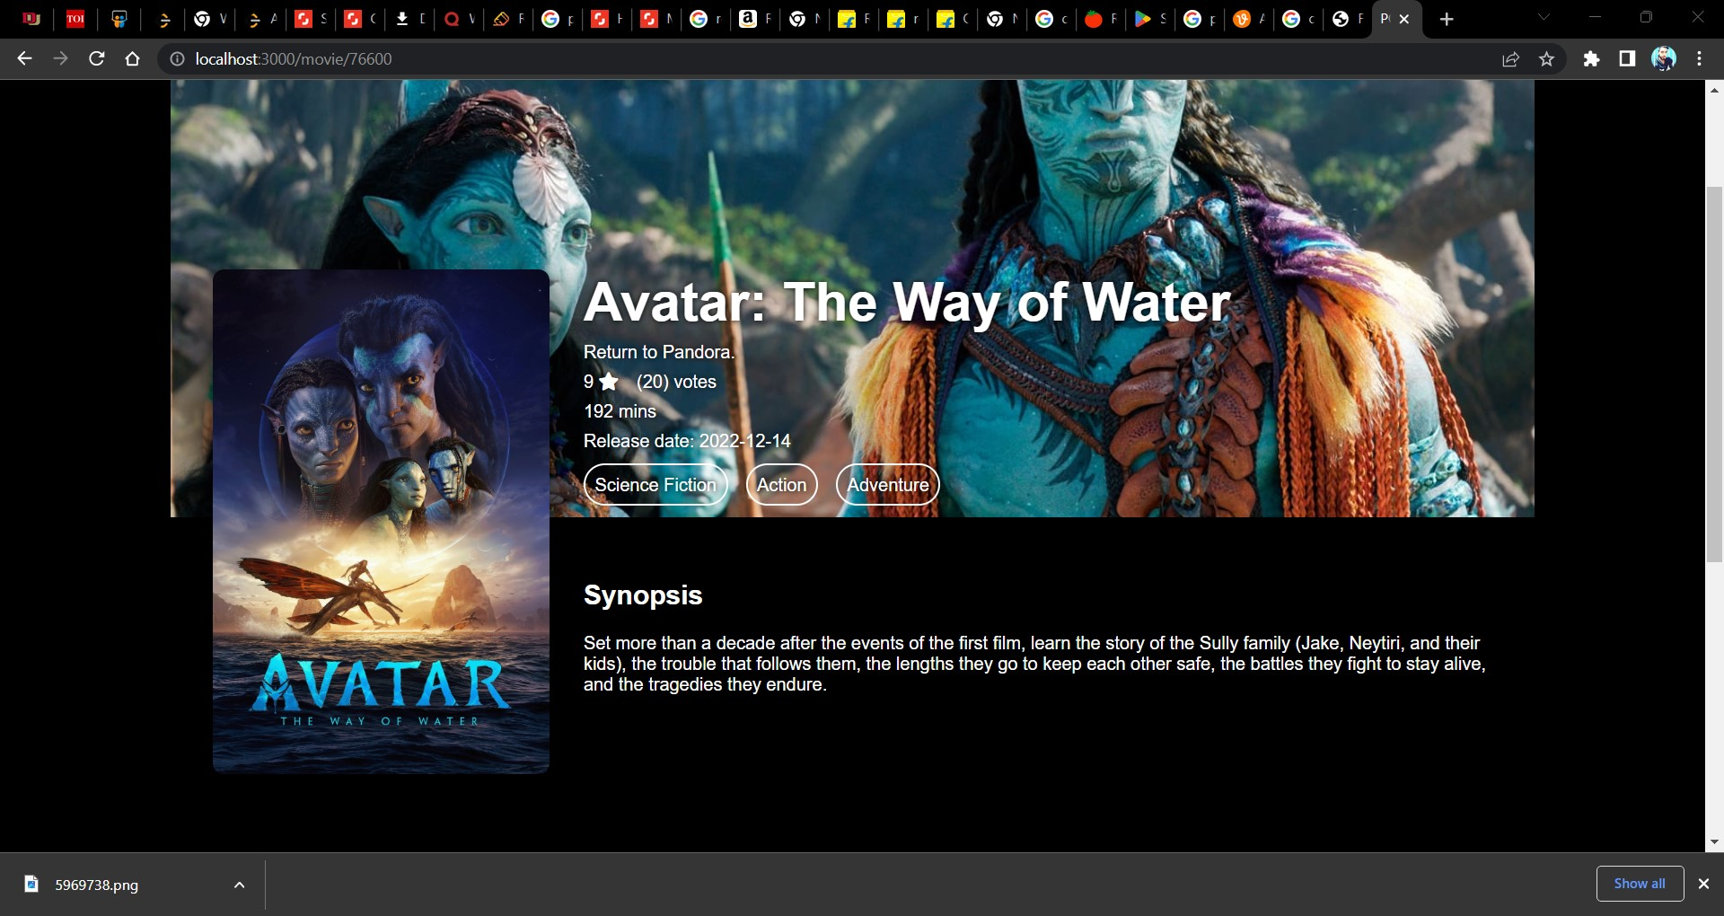
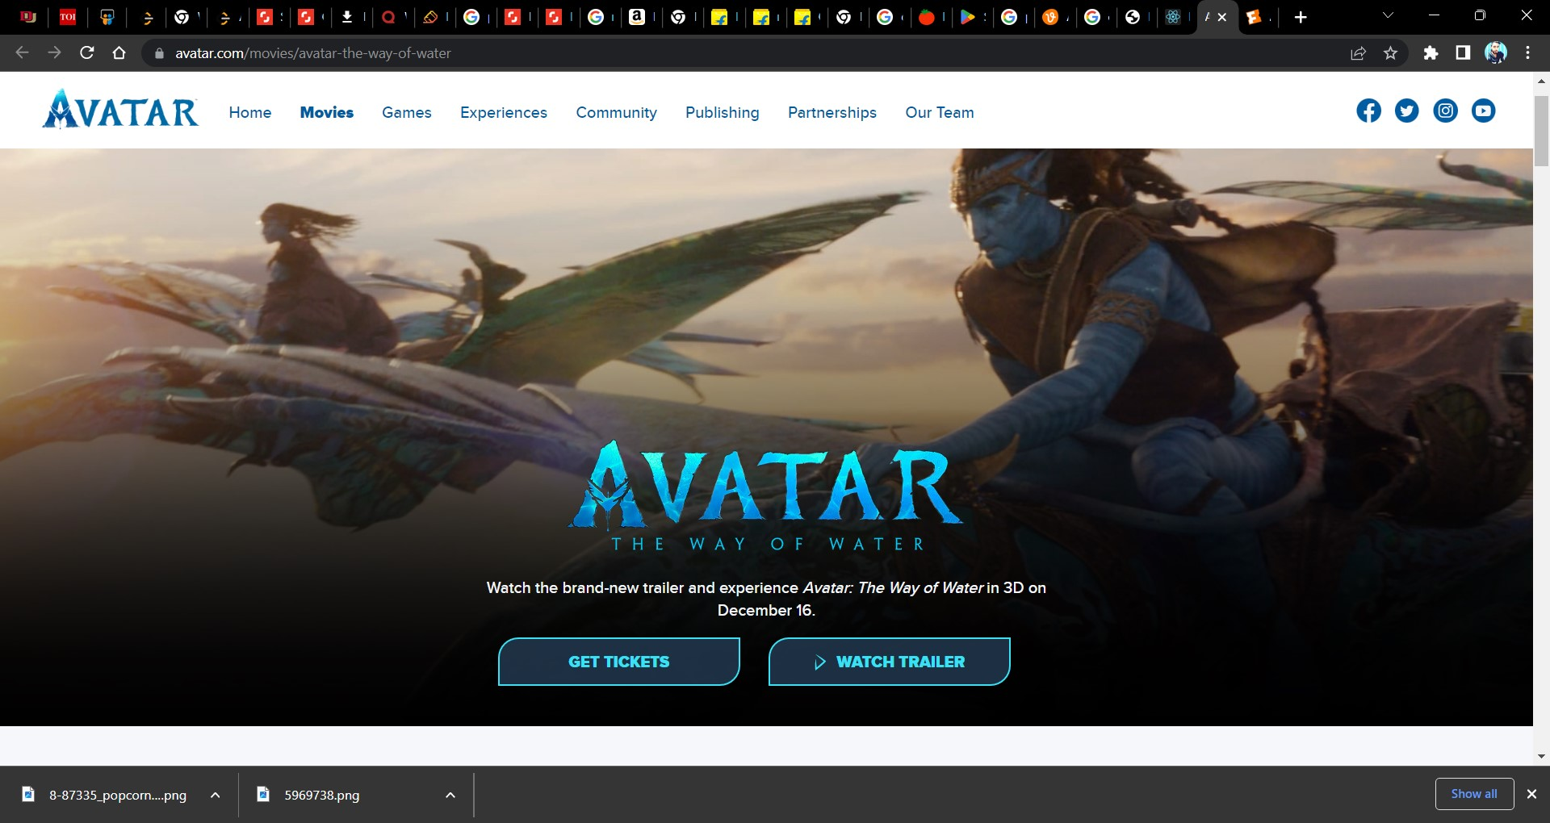

Slide 10




Aplication Used
H.T.M.L
CSS.
JAVA SCRIPT.
MYSQL (DATABASE).
CHROME (BROWSING).
REACT.
NODE JS.

Slide 11


Abstract
In this hustling world, entertainment is a necessity for each one of us to refresh our mood and
energy. Entertainment regains our confidence for work and we can work more enthusiastically.
For revitalizing ourselves, we can listen to our preferred music or can watch movies of our
choice. For watching favorable movies online we can utilize movie recommendation systems,
which are more reliable, since searching of preferred movies will require more and more time
which one cannot afford to waste. In this paper, to improve the quality of a movie
recommendation system, a Hybrid approach by combining content based filtering and
collaborative filtering, using Support Vector Machine as a classifier and genetic algorithm is
presented in the proposed methodology and comparative results have been shown which depicts
that the proposed approach shows an improvement in the accuracy, quality and scalability of the
movie recommendation system than the pure approaches in three different datasets. Hybrid
approach helps to get the advantages from both the approaches as well as tries to eliminate the
drawbacks of both methods.

Slide 12
Scope of the project.
The objective of this project is to provide accurate movie recommendations to users.
The goal of the project is to improve the quality of movie recommendation system, such as accuracy, quality and scalability of system than the pure approaches.
This is done using Hybrid approach by combining content based filtering and collaborative filtering, To eradicate the over load of the data, recommendation system is used as information filtering tool in social networking sites .
Hence, there is a huge scope of exploration in this field for improving scalability, accuracy and quality of movie recommendation systems Movie Recommendation system is very powerful and important system.
But, due to the problems associated with pure collaborative approach, movie recommendation systems also suffers with poor recommendation quality and scalability issues.

Slide 13
Methodology for Movie Recommendation
The hybrid approach proposed an integrative method by merging fuzzy kmeans clustering method and genetic algorithm based weighted similarity measure to construct a movie recommendation system. The proposed movie recommendation system gives finer similarity metrics and quality than the existing Movie recommendation system but the computation time which is taken by the proposed recommendation system is more than the existing recommendation system. This problem can be fixed by taking the clustered data points as an input dataset The proposed approach is for improving the scalability and quality of the movie recommendation system .We use a Hybrid approach , by unifying Content-Based Filtering and Collaborative Filtering, so that the approaches can be profited from each other. For computing similarity between the different movies in the given dataset efficiently and in least time and to reduce computation time of the movie recommender engine we used cosine similarity measure.

Slide 14
Conclusion
Conclusion.
In this project, to improve the accuracy, quality and scalability of movie review system, a Hybrid approach by unifying content based filtering and collaborative filtering; using Singular Value Decomposition (SVD) as a classifier and Cosine Similarity is presented in the proposed methodology. Existing pure approaches and proposed hybrid approach is implemented on three different Movie datasets and the results are compared among them. Comparative results depicts that the proposed approach shows an improvement in the accuracy, quality and scalability of the movie recommendation system than the pure approaches. Also, computing time of the proposed approach is lesser than the other two pure approaches.

Slide 15
Future scope
In the proposed approach, It has considered Genres of movies but, in future we can also consider age of user as according to the age movie preferences also changes, like for example, during our childhood we like animated movies more as compared to other movies. There is a need to work on the memory requirements of the proposed approach in the future. The proposed approach has been implemented here on different movie datasets only. It can also be implemented on the Film Affinity and Netflix datasets and the performance can be computed in the future.

Slide 16

The way to get started is to quit talking and begin doing.
Walt Disney

Slide 17





Thank you

